Slide 1
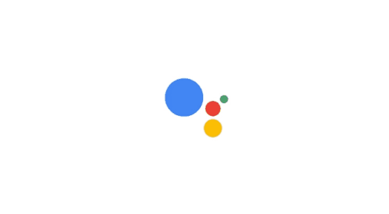
News Recommender Systems
Tomás Dodds | Leiden

Slide 2
News recommenders explained
Why do we need explanations? Because recommendations are usually opaque to the end user.
Explanations are especially needed when the system behaves in an unexpected manner (Miller, 2019).
AI Act
DSA
GDPR

Slide 3
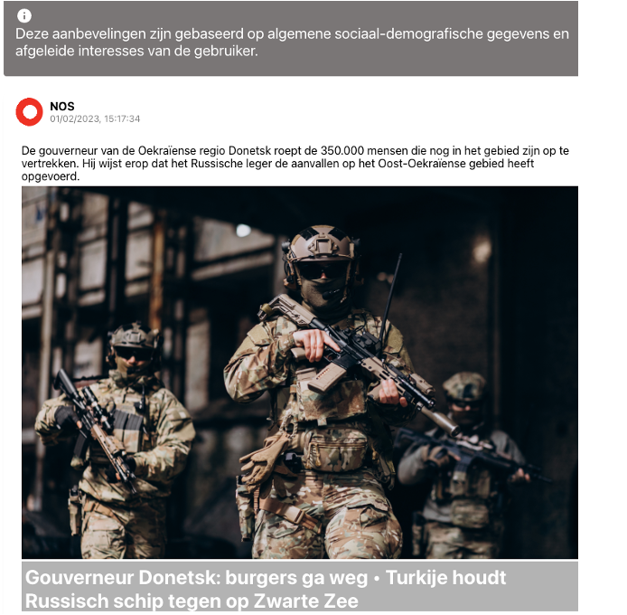
Challenges to explain

Slide 4
Challenges to explain
Explainability is the level to which a system can provide justifications for the cause of its decisions or outputs (Coeckelbergh, 2020).
One challenge is determining the level of detail that should be included in explanations for the general public (Büchi et al., 2021).

Slide 5
Challenges to explain
In a multimodal information ecosystem where voice interfaces are emerging (Newman, 2022) it is crucial to analyze the impact of various types of explanations in connection to the modality of interaction (e.g., text, voice).
The modality of the information can also influence in the explanation process (Turro, 2019).

Slide 6
Algorithmic news recommenders: “the ‘recommender’ portion of ‘algorithmic news recommenders’ refers to the use of so-called ‘recommender systems’ to somehow select a number of items out of a much larger pool which can then be presented in an interface to people.” (Sax, 2022)

Slide 7
Information overload: “Information overload is defined as the experience of feeling burdened by large amounts of information received too fast to be processed or used effectively.” (Xinfang, 2020).

Slide 8
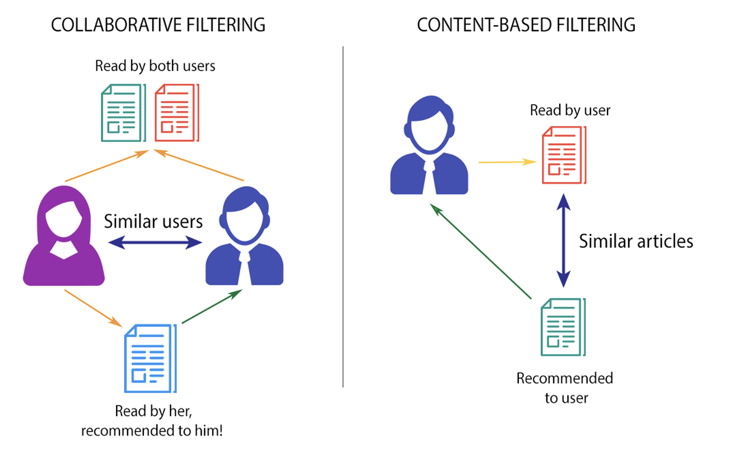
By A. K. Chaturvedi (2017)

Slide 9
Spotify (Coll. Filtering) – "We can understand songs to recommend to a user by looking at what other users with similar tastes are listening to." The algorithm simply compares users' listening history: if user A has enjoyed songs X, Y and Z, and user B has enjoyed songs X and Y (but haven't heard Z yet), we should recommend song Z to them. (Pastukhov, 2022)

Slide 10
Netflix (Mix Filtering) – “Whenever you access the Netflix service, our recommendations system strives to help you find a show or movie to enjoy with minimal effort. We estimate the likelihood that you will watch a particular title in our catalog based on a number of factors including:
your interactions with our service (such as your viewing history and how you rated other titles),
other members with similar tastes and preferences on our service, and
information about the titles, such as their genre, categories, actors, release year, etc.
In addition to knowing what you have watched on Netflix, to best personalize the recommendations we also look at things like:
the time of day you watch,
the devices you are watching Netflix on, and
how long you watch.” (Netflix, 2023)
Link

Slide 11
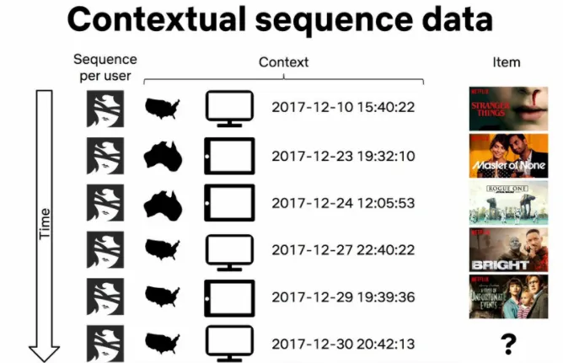
Video-Video Similarity Ranker —a.k.a. Because you watched (BYW), by Justin Basilico

Slide 12

“Amazon.com was one of the first organizations that relied on automated recommendations at scale, and early reports state that recommendations once accounted for more than 30% of cross-sales on the site (Linden et al., 2003).
Today, recommender systems are found almost everywhere, and their potential value to businesses in terms of various key performance indicators has been demonstrated in many application settings (cf. Jannach and Jugovac, 2019).”
(Ghanem et al. 2022)

Slide 13
Recommendation as a solution to drive engagement
Filter bubbles // Echo chambers
“Filter bubbles, in the sense of filtering decisions that include like-minded and exclude different-minded content, can be a real concern for a participatory democracy.”
(Helberger, 2019).

Slide 14
Journalistic values
The remarkable differences in attitudes towards the role of journalistic values in the design of ANRs indicate that there is no one-size-fits-all algorithmic solution.

Slide 15
The tyranny of preference: Similarity vs. Discovery
What about top stories?

Slide 16
Opacity
The alleged opacity of algorithms (Diakopoulos and Koliska 2017) adds to these concerns, as this opacity can make it more difficult to identify external influences on the media, as well as to hold the media accountable for the way they carry out their democratic task and journalistic mission.

Slide 17
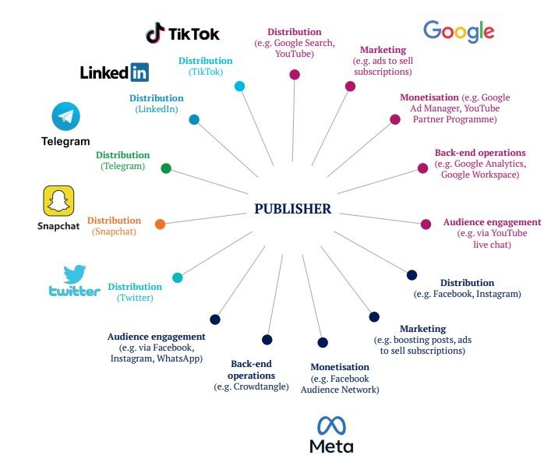
Platforms and publishers relation
Publishers work day to day with platforms.
Platforms compete with publishers for attention, for advertising, and for consumer spending.
However, publishers need to interact with platforms to gather public attention.

Slide 18
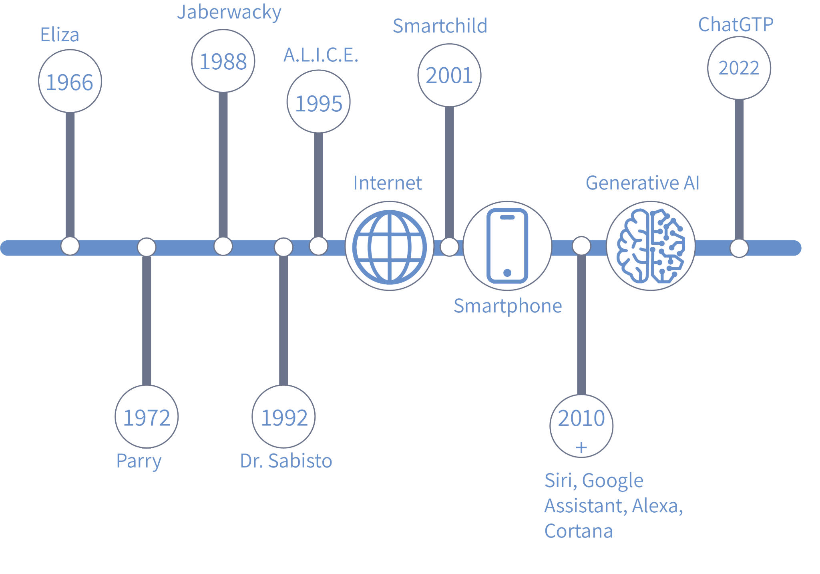
The rise of conversational agents

Slide 19

Definitions and types of CAs (chatbots, voice assistants, virtual agents)
“Software that accepts natural language as input and generates natural language as output, engaging in a conversation with the user” (Griol et al., 2013, p. 760).
Embodied and disembodied
Focuses on a type of conversational agent: voice assistants.
Contingency of messages
Modality

Slide 20
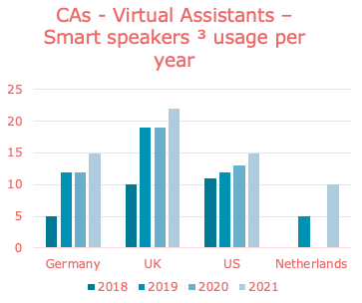
Conversational agents in the media ecosystem
In today's fragmented media environment, individuals access information through multiple means such as CAs, news websites, and social media (Vermeer et al., 2020).
News organizations look for new ways to interact with the public (e.g., social media, CAs).
1/5 users ask CAs for news regularly (Newman et al., 2019).
Numbers are expected to rise in the upcoming year (Newman et al., 2019).

Slide 21
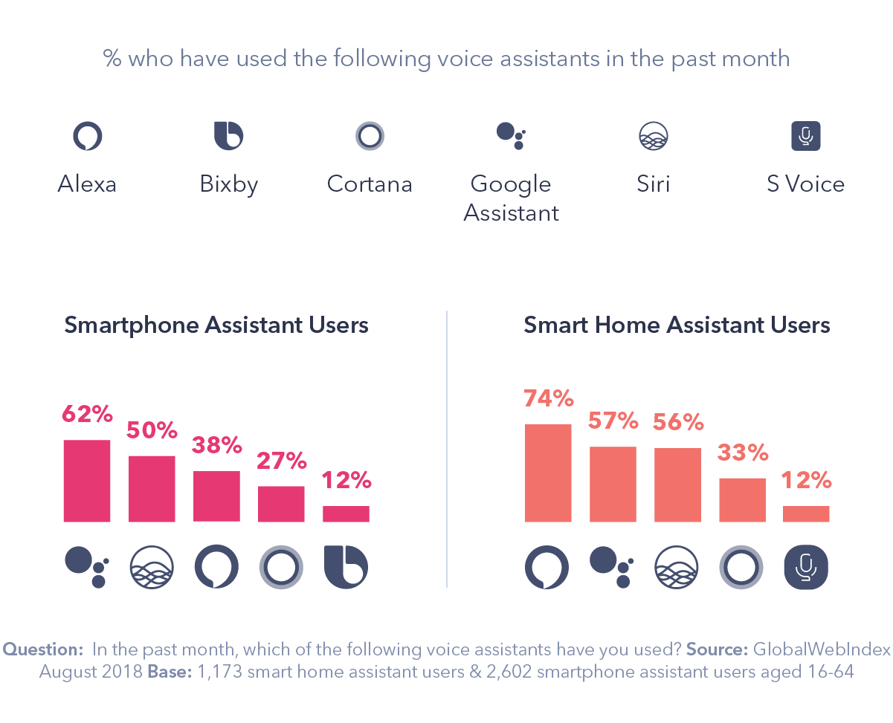
Key players in the market and their impact on the media landscape
The companies behind important CAs (Amazon, Google) are pushing media organizations to shift to audio news(Turow, 2021).
Winner takes all dynamics (Newman et al., 2019).

Slide 22
Advantages of news consumption via CAs
In addition, as these agents emulate natural language, they account for multiple strategies to strive for personalization (e.g., observing users' conversations, asking about users' choices) in comparison to other channels (e.g., search) (Alimamy & Kuhail, 2023).
Algorithmic recommendations
Formatting content
Asking questions
Timely information
Convenience and accessibility for users (orchestrators), as conversational agents can function as information providers, intermediaries, and affective companions by processing natural language users’ requests and selecting content while having a conversation with the user (Natale, 2021).
Routines
Social way of receiving news information [Mindless anthropomorphism] (Araujo, 2018).

Slide 23
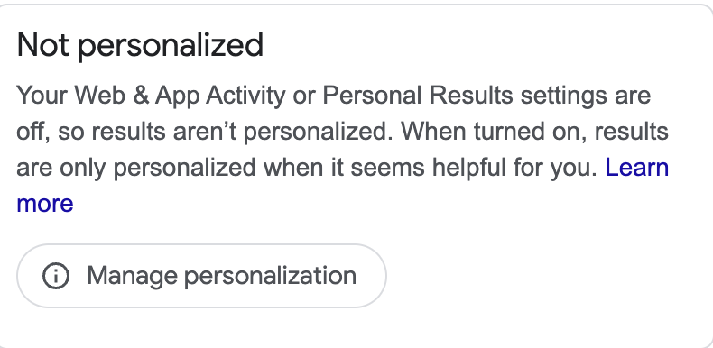
Challenges of CAs
Algorithmically curated information flows on these channels have the potential to shape users' public issue salience and impact democracy (Seipp et al., 2023).
Diversity
Algorithms, and the institutions behind them, often make opaque recommendations, making it difficult for users to understand the reasoning behind the system (Diakopoulos & Koliska, 2017; Liu & Wei, 2021; Shin, 2021).
News consumption in CAs follow a winner takes all dynamic (Newman, 2018).

Slide 24
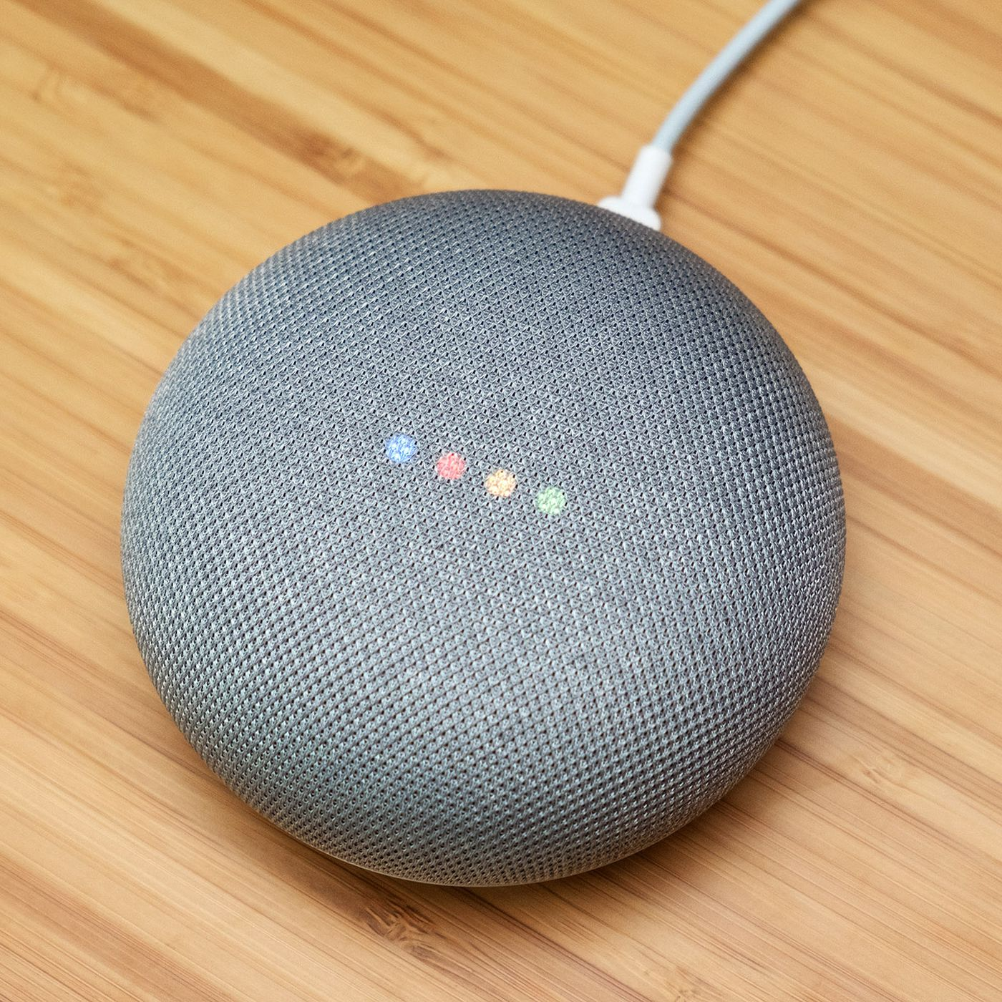

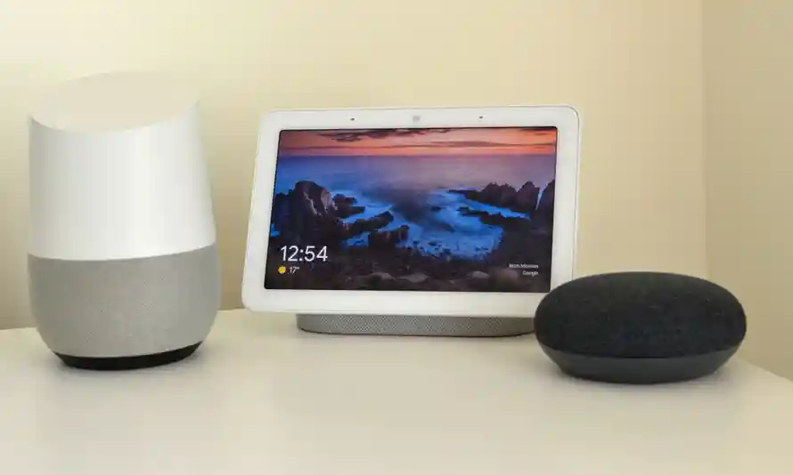
How do conversational agents influence issue salience?
Individuals can select their news sources for news consumption. News sources are limited. Most users decide not to customize¹.
Conversational agents can select the news sources for each individual².
It is not clear how the selection or ranking is made for each user³.
¹Newman et al., 2019; Weidmüller et al., 2021
²Gannes, 2019; Kinsella, 2019
³Weidmüller et al., 2021

Slide 25
Why are conversational agents (CAs) important for the media?
Companies behind important CAs (Amazon, Google) are pushing media organizations for a shift to audio news.
1/5 users ask CAs for news regularly.
Numbers are expected to rise in the upcoming years.
The adoption of CAs for news consumption can amplify the challenges within the media.

Slide 26

How CAs can influence issue salience?
Traditionally, news organizations are known as news gatekeepers
Nowadays, algorithms and the institutions behind them control the information the public is exposed to
Control of information represents a political power since it affects the perception of the most important issues (issue salience).
Most important issues help to shape public policies to address the most important problems.
CAs, as novel technologies impacting the distribution of news and information, can possess a political power that has been understudied.

Slide 27


What would be the role of CAs in a bigger picture?
Social media
Facebook
Mainstream news websites
NOS.nl
Algorithmically driven¹.
Editorially driven².
¹Rader and Gray, 2015
²Deuze, 2005
³Reuters, 2021

Slide 28
News Recommender Systems
Tomás Dodds | Leiden

